Slide 1
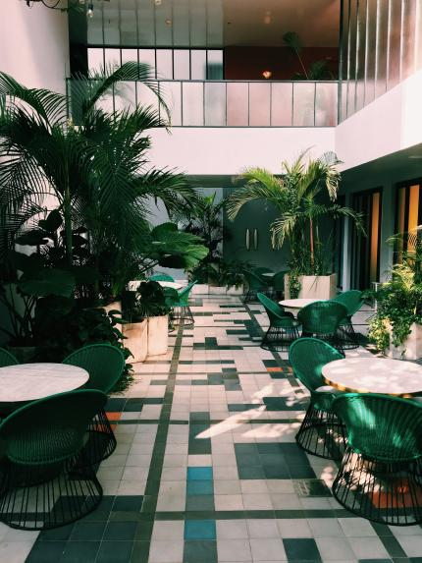
SQL Project
HOTEL RESERVATION DATA ANALYSIS
MENTORNESS

Slide 2
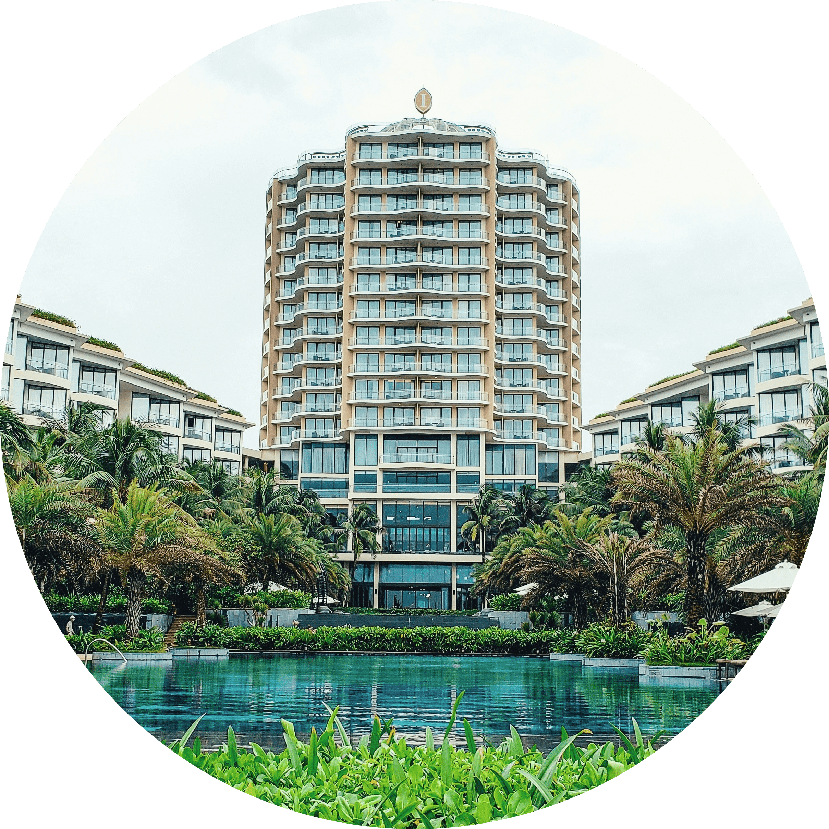
CONTENTS
DATASET DESCRIPTION | Quick overview of the features available in the dataset used.
PROBLEMS AND SYNTAX | The following slides cover different problems and how to solve them using SQL syntax.

Slide 3
DATASET FEATURES
Booking_ID: A unique identifier for each hotel reservation.
no_of_adults.
no_of_children.
no_of_weekend_nights.
no_of_week_nights.
type_of_meal_plan: The meal plan chosen by the guests. (Meal_Plan_1, Not Selected)
room_type_reserved: The type of room reserved by the guests. (Room_Type_1)
lead_time: The number of days between booking and arrival.
arrival_date.
market_segment_type: The market segment of the reservation. (Online, Offline)
avg_price_per_room.
booking_status: The status of the booking. (Cancelled, Not_Cancelled)

Slide 4
Q1. What is the total number of reservations in the dataset?
SQL Syntax:
SELECT COUNT(*) AS total_reservations
FROM mentorness.hotel_data;
Answer:
700

Slide 5
Q2. Which meal plan is the most popular among guests?
SQL Syntax:
SELECT type_of_meal_plan, COUNT(*) AS meal_plan_count
FROM mentorness.hotel_data
GROUP BY type_of_meal_plan
ORDER BY meal_plan_count DESC
LIMIT 1;
Answer:
Meal Plan 1 with 527 reservations

Slide 6
Q3. What is the average price per room for reservations involving children?
SQL Syntax:
SELECT AVG(avg_price_per_room) AS avg_price_for_children
FROM mentorness.hotel_data
WHERE no_of_children > 0;
Answer:
144.568

Slide 7
Q4. How many reservations were made for the year 20XX?
SQL Syntax:
SELECT COUNT(*) AS reservations_in_year
FROM mentorness.hotel_data
WHERE YEAR(STR_TO_DATE(arrival_date, '%d-%m-%y')) = 2017
;
Answer:
This query could not be resolved correctly, resulting in 0.

Slide 8
Q5. What is the most commonly booked room type?
SQL Syntax:
SELECT room_type_reserved, COUNT(*) AS room_type_count
FROM mentorness.hotel_data
GROUP BY room_type_reserved
ORDER BY room_type_count DESC
LIMIT 1;
Answer:
Room Type 1 was the most commonly booked room with 534 bookings.

Slide 9
Q6. How many reservations fall on a weekend (no_of_weekend_nights > 0)?
SQL Syntax:
SELECT COUNT(*) AS weekend_reservations
FROM mentorness.hotel_data
WHERE no_of_weekend_nights > 0;
Answer:
383 reservations

Slide 10
Q7. What is the highest and lowest lead time for reservations?
SQL Syntax:
SELECT MAX(lead_time) AS max_lead_time, MIN(lead_time) AS min_lead_time
FROM mentorness.hotel_data;
Answer:
Highest = 443, Lowest = 0

Slide 11
Q8. What is the most common market segment type for reservations?
SQL Syntax:
SELECT market_segment_type, COUNT(*) AS segment_count
FROM mentorness.hotel_data
GROUP BY market_segment_type
ORDER BY segment_count DESC
LIMIT 1;
Answer:
Online segment is the most common with 518 records.

Slide 12
Q9. How many reservations have a booking status of "Confirmed"?
SQL Syntax:
SELECT COUNT(*) AS confirmed_reservations
FROM mentorness.hotel_data
WHERE booking_status = 'Confirmed';
Answer:
493 confirmed reservations

Slide 13
Q10. What is the total number of adults and children across all reservations?
SQL Syntax:
SELECT SUM(no_of_adults) AS total_adults, SUM(no_of_children) AS total_children
FROM mentorness.hotel_data;
Answer:
Total Adults = 1316, Total Children = 69

Slide 14
Q11. What is the average number of weekend nights for reservations involving children?
SQL Syntax:
SELECT AVG(no_of_weekend_nights) AS avg_weekend_nights_with_children
FROM mentorness.hotel_data
WHERE no_of_children > 0;
Answer:
1

Slide 15
Q12. How many reservations were made in each month of the year?
SQL Syntax:
SELECT MONTH(STR_TO_DATE(arrival_date, '%d-%m-%y')) AS month,
COUNT(*) AS reservations_count
FROM mentorness.hotel_data
GROUP BY month
ORDER BY month;
Answer:
January: 11 February: 28 March: 52 April: 67
May: 55 June: 84 July: 44 August: 70
September: 80 October: 103 November: 54 December: 52

Slide 16
Q13. What is the average number of nights (both weekend and weekday) spent by guests for each room type?
SQL Syntax:
SELECT room_type_reserved, AVG(no_of_weekend_nights + no_of_week_nights) AS avg_total_nights
FROM mentorness.hotel_data
GROUP BY room_type_reserved;
Answer:
Room Type 1: 2.8783 Room Type 5: 2.5000
Room Type 2: 3.0000 Room Type 6: 3.6111
Room Type 4: 3.8000 Room Type 7: 2.6667

Slide 17
Q14. For reservations involving children, what is the most common room type, and what is the average price for that room type?
SQL Syntax:
SELECT room_type_reserved, COUNT(*) AS room_type_count, AVG(avg_price_per_room) AS avg_price
FROM mentorness.hotel_data
WHERE no_of_children > 0
GROUP BY room_type_reserved
ORDER BY room_type_count DESC
LIMIT 1;
Answer:
Most common room type = Room Type 1,
Average Price = 123.122

Slide 18
Q15. Find the market segment type that generates the highest average price per room.
SQL Syntax:
SELECT market_segment_type, AVG(avg_price_per_room) AS avg_price
FROM mentorness.hotel_data
GROUP BY market_segment_type
ORDER BY avg_price DESC
LIMIT 1;
Answer:
Online market generates the highest price per room at 112.455

Slide 19
Conclusion
In conclusion, we have analyzed various aspects of hotel reservations, including guest preferences, booking trends, and operational factors. The insights gained from this analysis can help the hotel make informed decisions to enhance guest experience and improve operations.

Slide 20
Thank You
Presented By: Shreyash Kumar (Batch: MIP-DA-10)

